Slide 1
Social Media Data Mining
Project Presentation
4/26/2019
Project Report
5/8/2019

Slide 2
Sentiment Analysis Of Tweets
On Robot Cars
Submitted By
Nishanth Reddy Bandaru
Kavya Sri Barlapudi
Akshitha Duddala
Sravya Kongara
Lakshmi Harshini Kuchibhotla

Slide 3
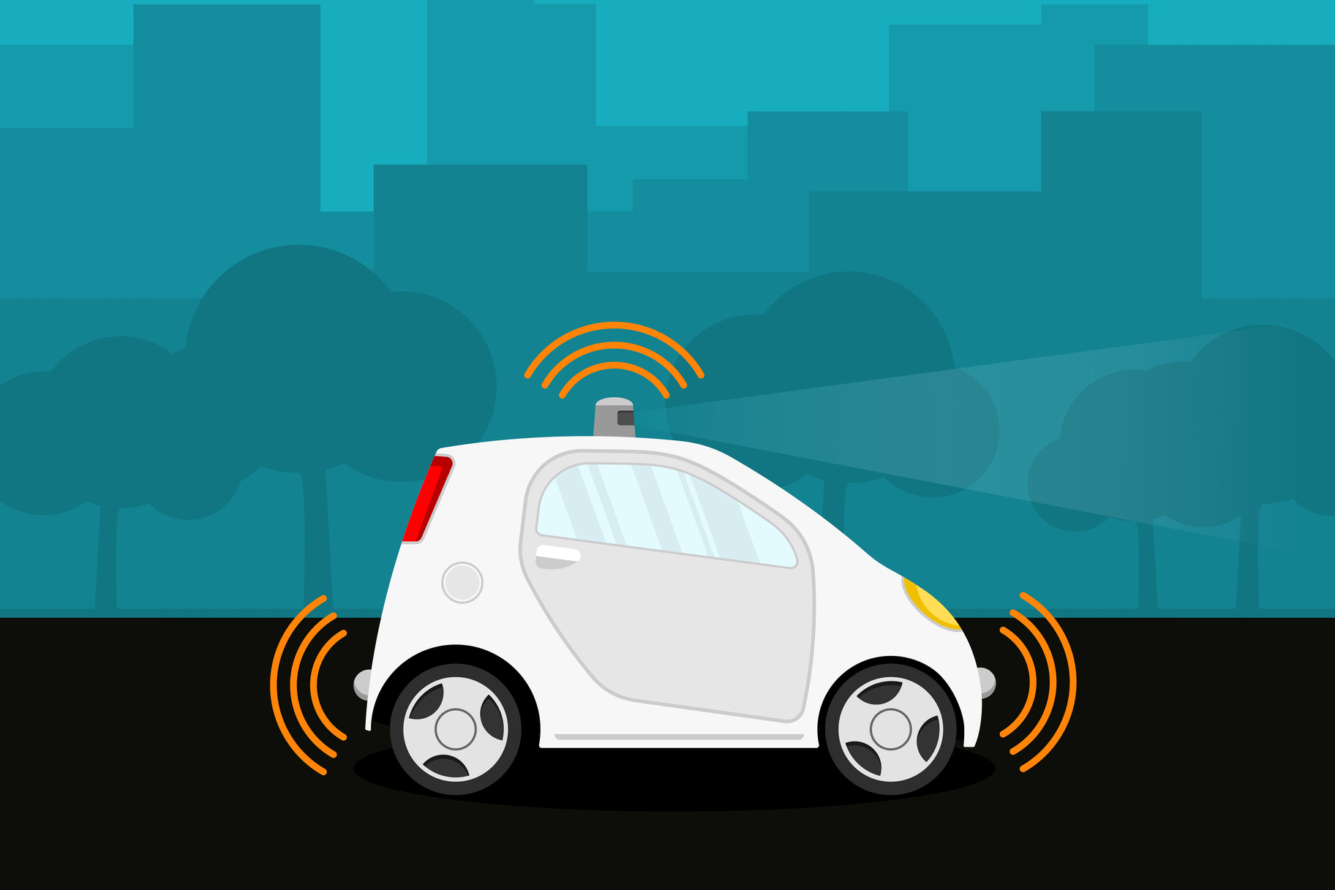
Why Analyze The Tweets on Robot Cars?
To determine attitude of people towards it
To overcome the reason for the negative feedback
To encourage the accepted features
To determine the future scope

Slide 4
Process Flow
Data extraction
Data cleaning and processing
Classification of data:
We perform classification by using two classifiers Naïve Bayes and Support Vector Machine
Depiction of results in the form of bar graphs which helps inferring the results for future suggestions.

Slide 5
Positive
regex expression
Extracted data
Cleaned data
Classification
Neutral
Negative

Slide 6
Data Extraction
-Data Collection
We extract the tweets from twitter with hashtags ‘robot cars’, ‘selfdrivingcars’, ‘autonomous vehicle’ or ‘driverless-cars’
got3 module is used to extract older tweets to make up for the smaller data set generated by Tweepy API.
- got3 module automates the calls to the JSON provider which loads the older tweets.

Slide 7
-Data Cleaning
The extracted data needs to be cleaned to produce accurate results.
Data cleaning is done using regex expressions.
Usernames, URLs, encoded strings etc. are cleaned from the tweets.

Slide 8
Data Labelling
POSITIVE | NEGATIVE | NEUTRAL
-Denotes users who are eager and excited about this technology. Positive words include “:)”, “:D”, nice, great, future, do, perfect, express, faster | -Denotes users who are not excited or are apprehensive about this technology. Negative words include “:(“, “:’(“, crashes, sleep, liable, disruptive, don’t | -Denotes users who do not have any opinion about this technology. Neutral words include “:|”, questionable,
- Manual labelling of the training data is done using IRR.
- Inter-rater reliability (IRR) is defined as the degree of agreement among different raters

Slide 9
Classification Using Naïve Bayes
Why Naïve Bayes?
Efficient for comparatively less volume of data
It is simple and well-formed classifier
It provides optimal standard decision making and also useful for statistical predictions.
The data set elements or attributes are independent.

Slide 10

Naïve Bayes Classifier
A classifier based on Bayes Theorem
Multinomial Bayes theorem is used because multiple occurrences of words are considered while performing sentiment analysis.
Works like a bag of words model
- The score of a particular tweet is calculated based on the occurrence of the words in the respective word lists.

Slide 11
Predicted Output Naïve Bayes Predictions
Output generated for Train Data
-----Analysis of Naive Bayes Train Data------
Actual Train data Sentiment Count: Counter({'positive': 463, 'neutral': 358, 'negative': 54})
Naive Bayes Train data Sentiment Count: Counter({'positive': 542, 'neutral': 333})
Output generated for Test Data
-----Analysis of Naive Bayes Test Data------
Actual Test Data Sentiment Count: Counter({'positive': 150, 'negative': 27, 'neutral': 24})
Naive Bayes Test Data Sentiment Count: Counter({'positive': 151, 'neutral': 50})

Slide 12
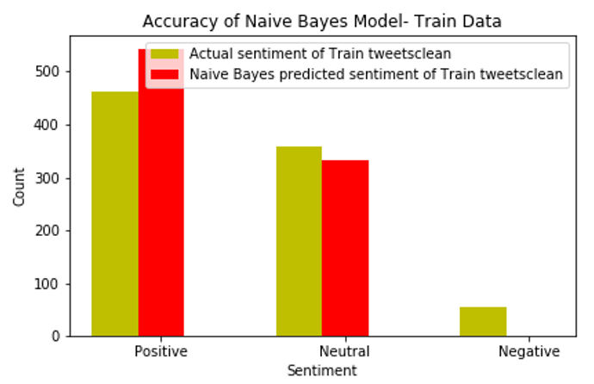
Visualization
Naïve Bayes Predictions – Bar Graph Representation

Slide 13
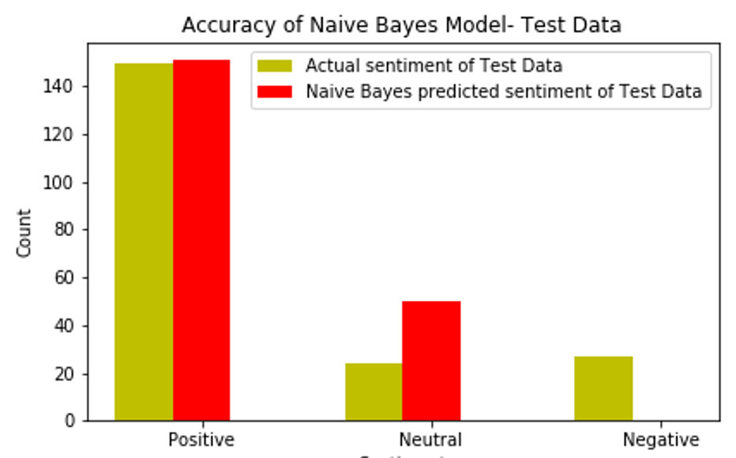

Slide 14
Classification Using SVM
Why SVM?
Produces pretty good accuracy.
Works efficiently when data is even inseparable.
Uses subsets of training points called support vectors in decision making thus making it memory efficient.
Can be implemented using multiple kernel methods

Slide 15
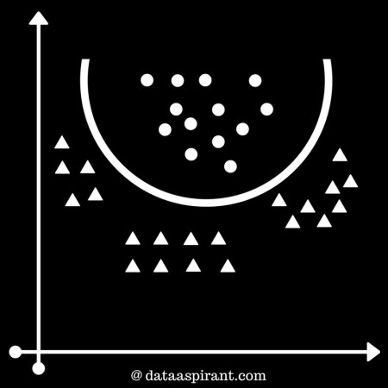
SVM Classifier
It is a non-probabilistic binary linear classifier.

Slide 16
SVM classifier draws a hyperplane that segregates the classes. To find the best hyperplane, the classifier does 2 things.
1.) Determine all the hyperplanes that best segregates the classes
2.) Choose the hyperplane from the hyperplanes set which has the highest margin between the support vectors
The steps performed after extraction of tweets:
Preprocessing
Training – Vectorizing the data
Testing
Negative tweet analysis

Slide 17
Predicted Output SVM Predictions
Output generated for Train Data
-----Analysis of SVM Train Data------
Actual Test Data Sentiment Count: Counter({'positive': 463, 'neutral': 358, 'negative': 54})
SVM Test Data Sentiment Count: Counter({'positive': 462, 'neutral': 377, 'negative': 36})
Output generated for Test Data
-----Analysis of SVM Test Data------
Actual Test Data Sentiment Count: Counter({'positive': 150, 'negative': 28, 'neutral': 24})
SVM Test Data Sentiment Count: Counter({'positive': 141, 'neutral': 60})

Slide 18
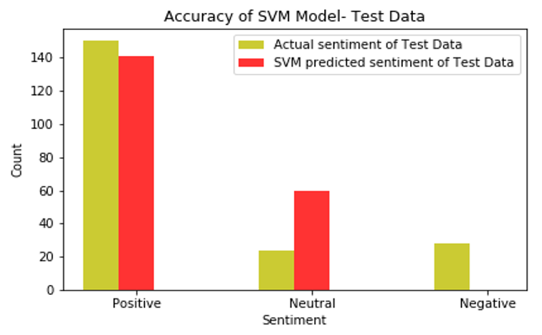
Visualization
SVM Predictions – Bar Graph Representation

Slide 19
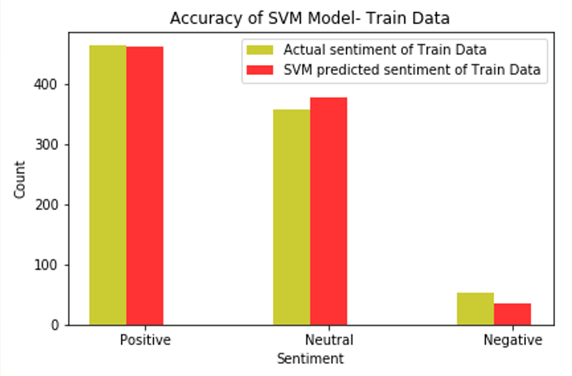

Slide 20
Observations
Naïve Bayes
Produced good accuracy with training data but the resultant graphs are not evenly distributed.
Since the number of positive and neutral tweets are more than the negative tweets and positive tweets are pretty similar, it can not identify the negative tweets during training phase.

Slide 21
SVM:
More efficient results.
Although the number of negative tweets are less than the number of neutral and positive tweets, it is still able to classify the negative tweets, however resulted in poor training for the classifier.
Hence it is not able to determine robust hyperplanes that could classify the tweets into 3 classes.

Slide 22
Conclusion
From the extracted positive and negative collection of tweets we found that more people are optimistic about the future of this product, while some people find self-driving cars dangerous and risky
This analysis is extremely beneficial for the manufacturers so that they can include various functionalities in their product to meet the expectations and needs of the public.

Slide 23
Future Research
Our classifiers does not consider the order of the words in the tweets.
Future work should focus on the “connectedness" factor.
Recurrent Neural Networks will take into account the relationship among different words and help in better classification.
Another area of future research would be related to more detailed analysis of the negative tweets.
This could be done by performing testing on the tweets generated from the states where the self driving cars are in use.

Slide 24
References
http://blog.datumbox.com/machine- learning-tutorial-the-naive-bayes-text-classier/.
http://ataspinar.com/2016/02/15/sentiment-analysis- with-the-naive-bayes-classier/.
https://towardsdatascience.com/creating-the-twitter-sentiment-analysis-program-in-python-with-naive-bayes-classification-672e5589a7ed
https://github.com/jeerson- henrique/getoldtweets-python/tree/master/got3.
https://en.wikipedia.org/wiki/recurrentneuralnetwork
https://en.wikipedia.org/wiki/supportvectormachine
https://www.wired.com/story/mobileye-self- driving-cars-arizona/.

Slide 25

THANK YOU

